Slide 1

The knowledge competition about the brain
for high school students
There are also exhibitions/keynotes to discover and experience what kind of brain researches happen in the Netherlands (Groningen)
Knowledge quizzes with:
Multiple choice questions
Brain Anatomy
Patient diagnosis
An exciting final round
For example...

Slide 2
*The questions are all in English in the Brain Olympiad
For example...
From which brain area
do you see a slice here?
What brain disease do you see in the right picture?
You don’t know the answers? No problem.
You can receive a book “BrainFacts” and a study guide to prepare yourself well for the quizzes!
The winner will represent the Netherlands during the International Brain Bee in Paris!!

Slide 3
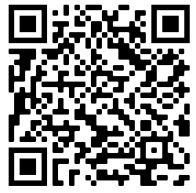


How can I participate??
You can register until 31 december 2021 on
www.hersenolympiade.nl
or scan the QR-code NOW!!
And don’t forget to follow our social media ☺

